Slide 1
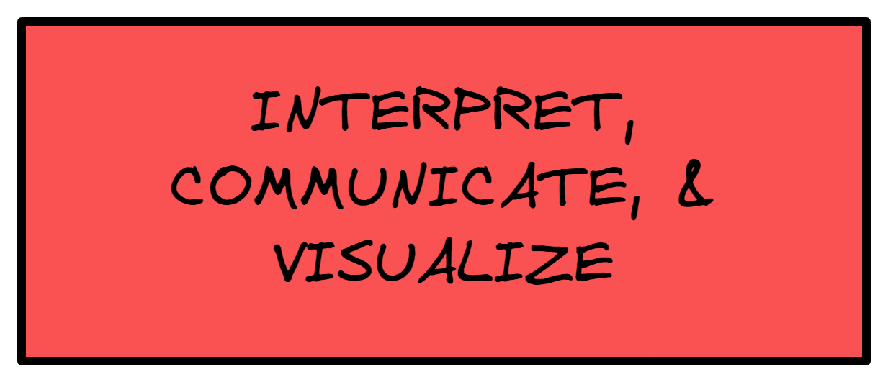
Notes:
Further Notes

Slide 2
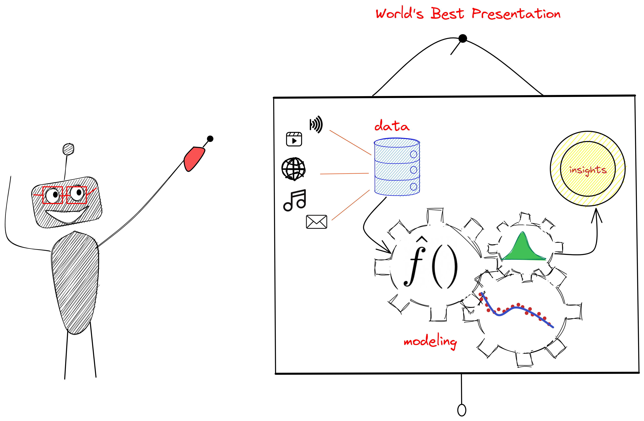
Notes:
Further Notes
-Spiral (golden ratio) Formula https://en.wikipedia.org/wiki/List_of_spirals
- Nautilus picture https://justcreative.com/how-to-use-the-golden-ratio-in-design-with-examples/
- http://stat.wharton.upenn.edu/~lzhao/teaching/stat102/Sections/Lect3_SimpleRegression.pdf (Paper on Parents to Child Height)

Slide 3
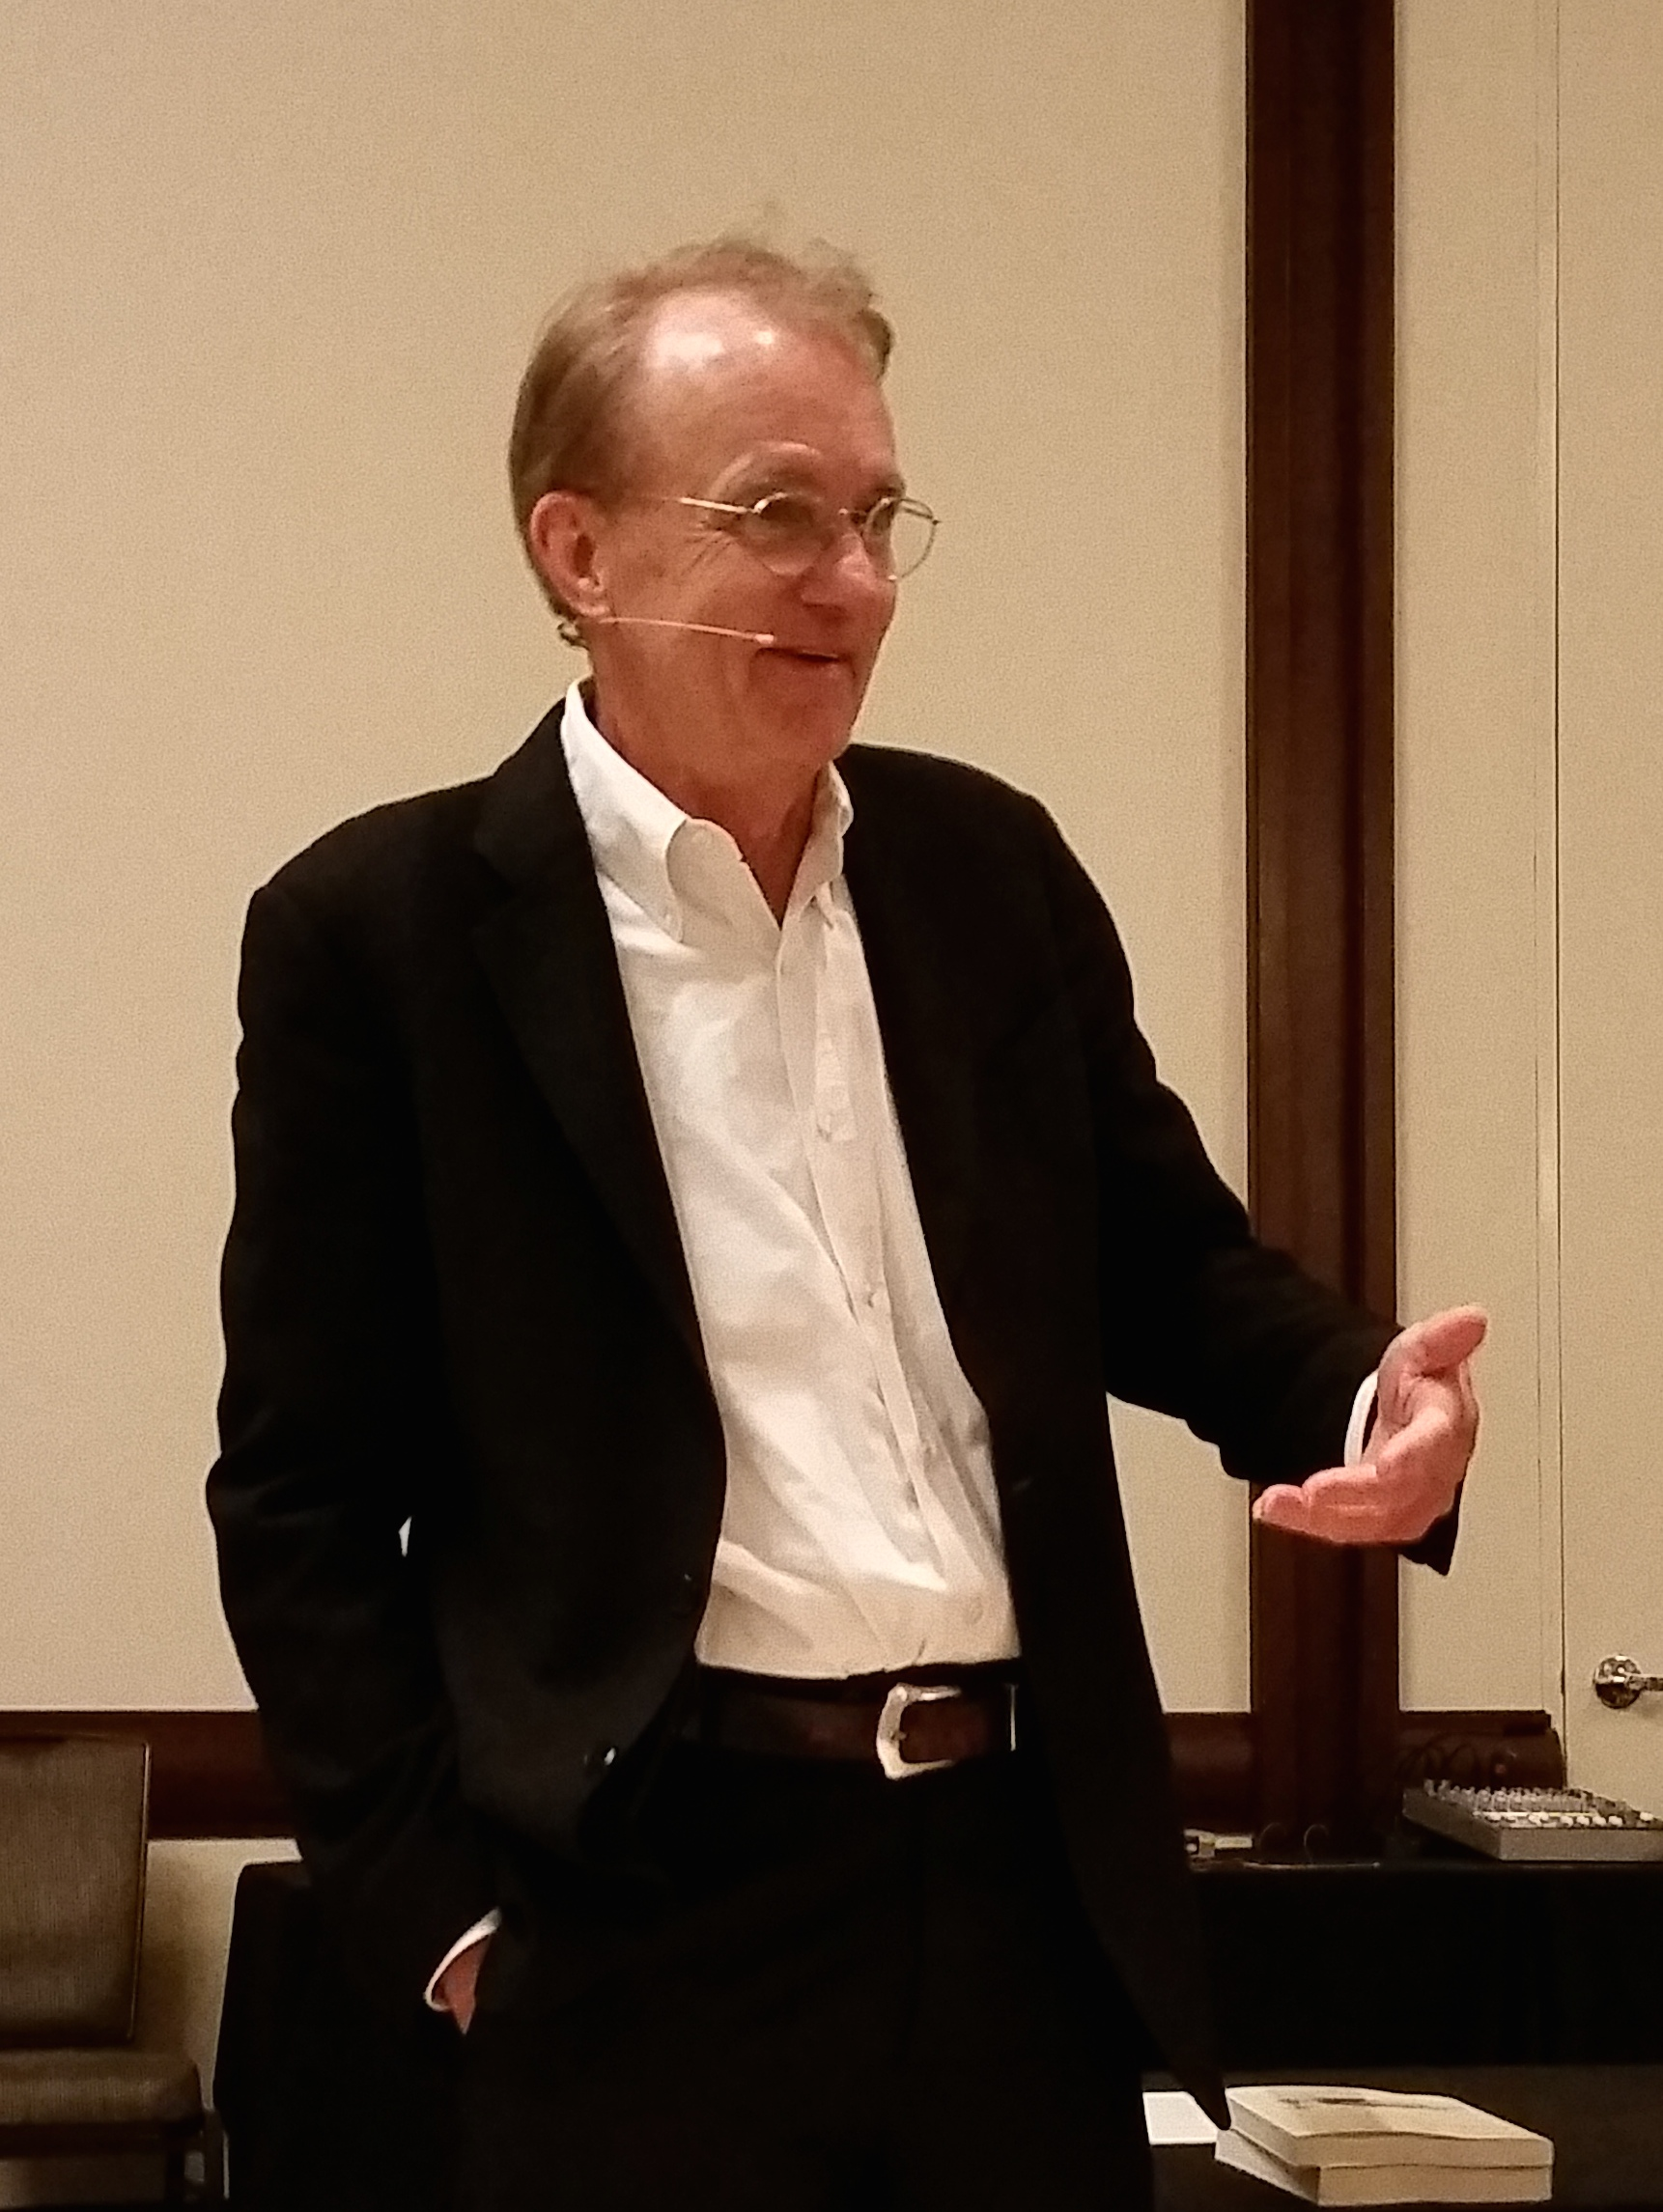
Presentation
"Graphical excellence is that which gives to the viewer the greatest number of ideas in the shortest time with the least ink in the smallest space."
Edward R Tufte,
The Visual Display of Quantitative Information
Notes:
Further Notes
https://www.analytics-toolkit.com/glossary/statistical-model/
Prominent statistician George Box famously remarked that "All models are false, but some are useful!" which is sometimes misunderstood by focusing on the first part and interpreting it as meaning that nothing can be learned through statistical models while completely forgetting the second part. However, the first part is a mere truism: a model is by definition an imperfect representation of a complex mechanism. The second part, however, is what is really interesting and it tells us that we can use models to guide decisions in the real world. The quote that gives the most context is in fact: "Remember that all models are wrong; the practical question is how wrong do they have to be to not be useful." [1] which obviously shifts the focus from the first part to the issue of mis-specification testing (testing for departures in assumptions).

Slide 4
Presentation
Skills of A Data Scientists
In a blogpost, Mike Driscoll (Harvard alumni, entrepreneur, investor, ….) proposes "The three sexy skills of data geeks."
Statistics ("studying"), the most important and most difficult to master given its rigor and ever progressing recent development.
Data munging ("suffering"), the second most important referring to the "painful" process of cleaning, parsing, and proofing one's data before it is usable for analysis- real world data is messy. Whether it is cleaning, combining datasets, or making use of big data distributed storage systems data processing remains ever more important.
Visualization ("storytelling"), is "the easiest to believe one has", although exposure to basic graphics is common to most data scientists, the ability to communicate ("narrate a story") to a wider and more general audience is a skill in itself!
Notes:
Further Explanation

Slide 5
Presentation
Effective Presentations
Whatever the domain of the presentation, it entails a three-part function composed of
Communication, deliver a message that is engaging to audience
Reception, ensure the message can be recalled by the audience
Action, ensure that message pushes the audience to act upon newly found information

Slide 6
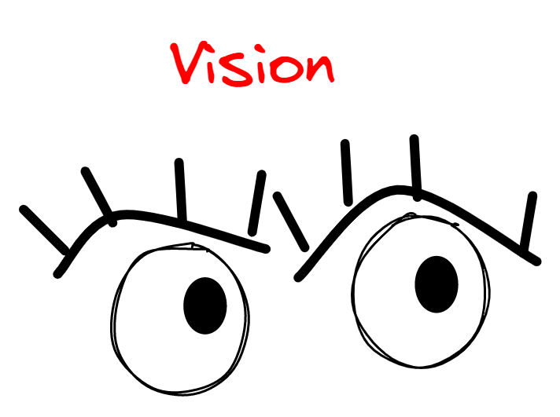
Presentation
Effective Presentations
Neurological factors that impact the success (or failure) of a presentation.
Vision
Between 80 and 90% of the information that our brain processes comes in through our eyes
two-thirds (66%) of the brain’s electrical activity is dedicated to vision when the eyes are open.

Slide 7
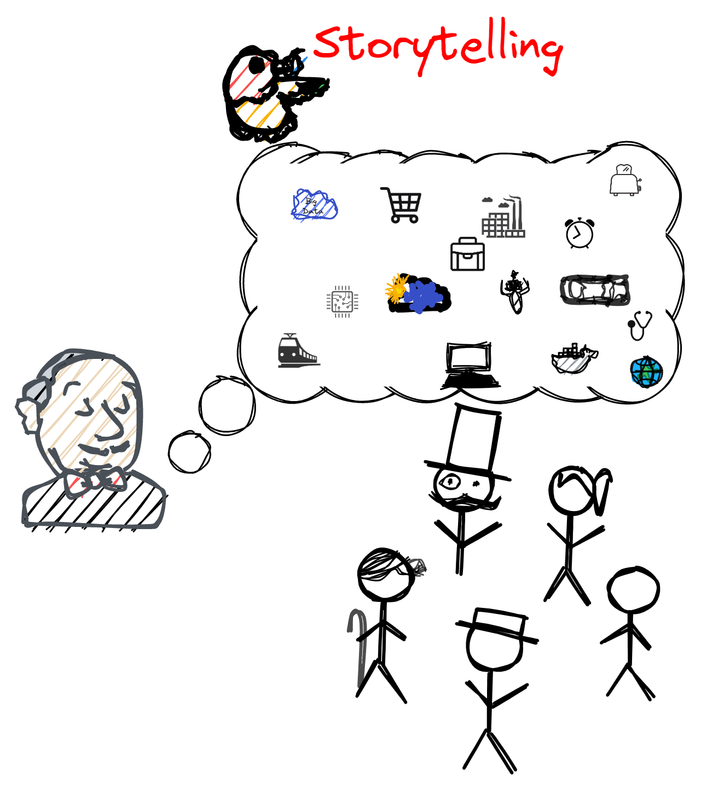
Presentation
Effective Presentations
Neurological factors that impact the success (or failure) of a presentation.
Storytelling
A biological predilection for stories.
Personal stories make up 65% of our conversations—a fact that is rooted in the ways that stories engage our brains.

Slide 8
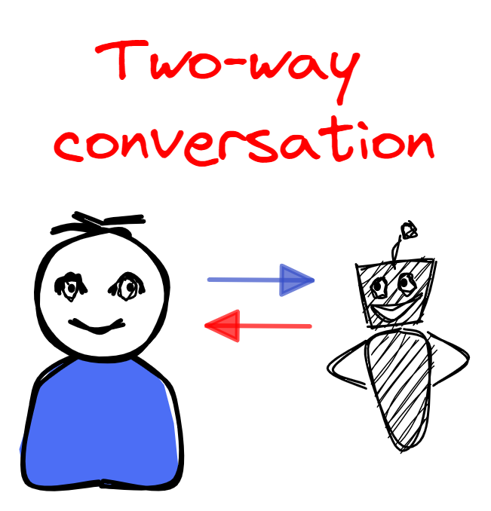
Presentation
Effective Presentations
Neurological factors that impact the success (or failure) of a presentation.
Two-way Conversation
Conversation allows the brains to experience the same brain patterns as if present.
Neural coupling, the phenomenon in which a conversation mirrors the same brain activity – a "listener’s brain activity mirrors the speaker’s brain activity."
"More extensive speaker-listener neural couplings result in more successful communication."

Slide 9
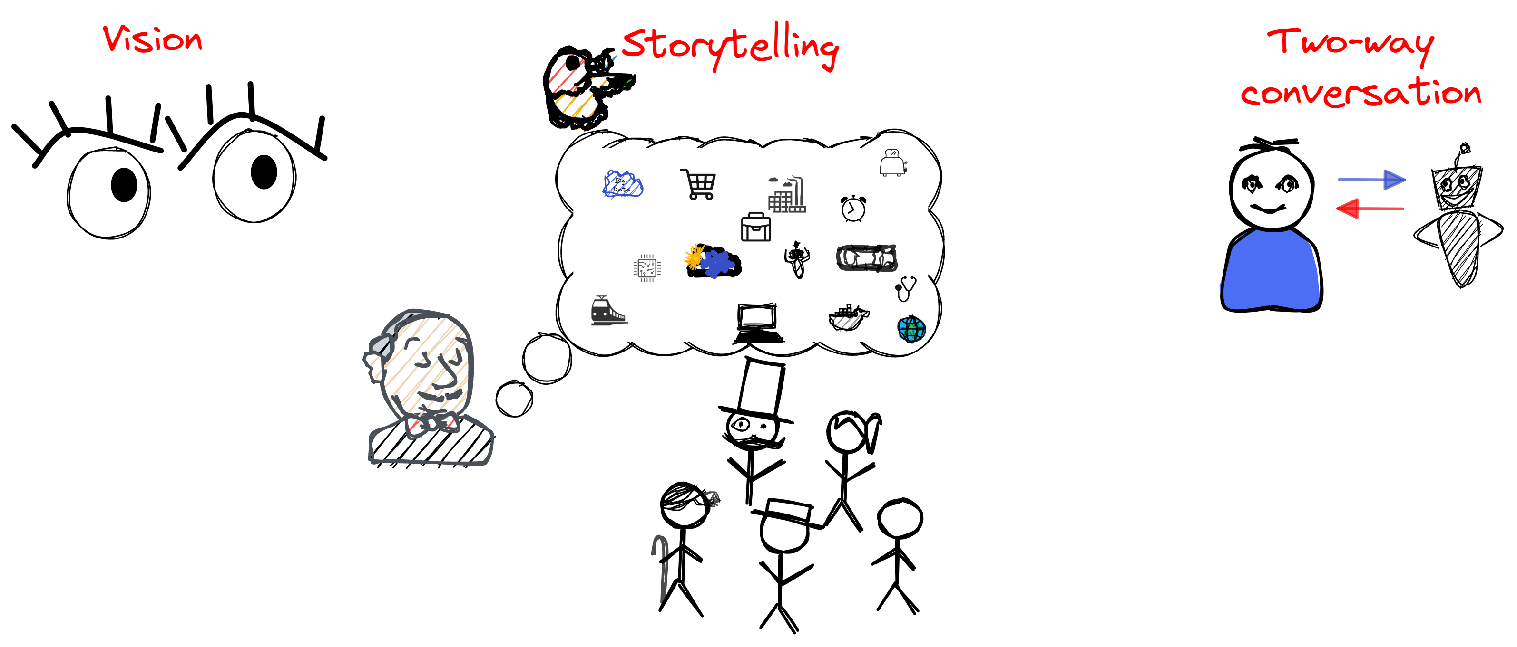
Presentation
Effective Presentations
As a result, any analyst who desires to deliver an effective presentation needs to take into account such powerful and important neurological factors.

Slide 10
Presentation
Effective Presentations
Use visuals to persuade the audience to take action
The mere use of visualizations increased audience action by 43%
Stories are more powerful than raw statistics
Data alone is too sterile to have an effect on emotional being such as humans; a story that brings vivid emotions out as a result of relatable information is much more effective
Engaging the audience in the "conversation" (a.k.a. presentation) is key to success
A two-way exchange allows for a better understanding of each other's points of view/ needs and struggles, aids the audience feel as working towards a common mission/goal, and results in efficacy in the achievement of a particular desired action/outcome.

Slide 11
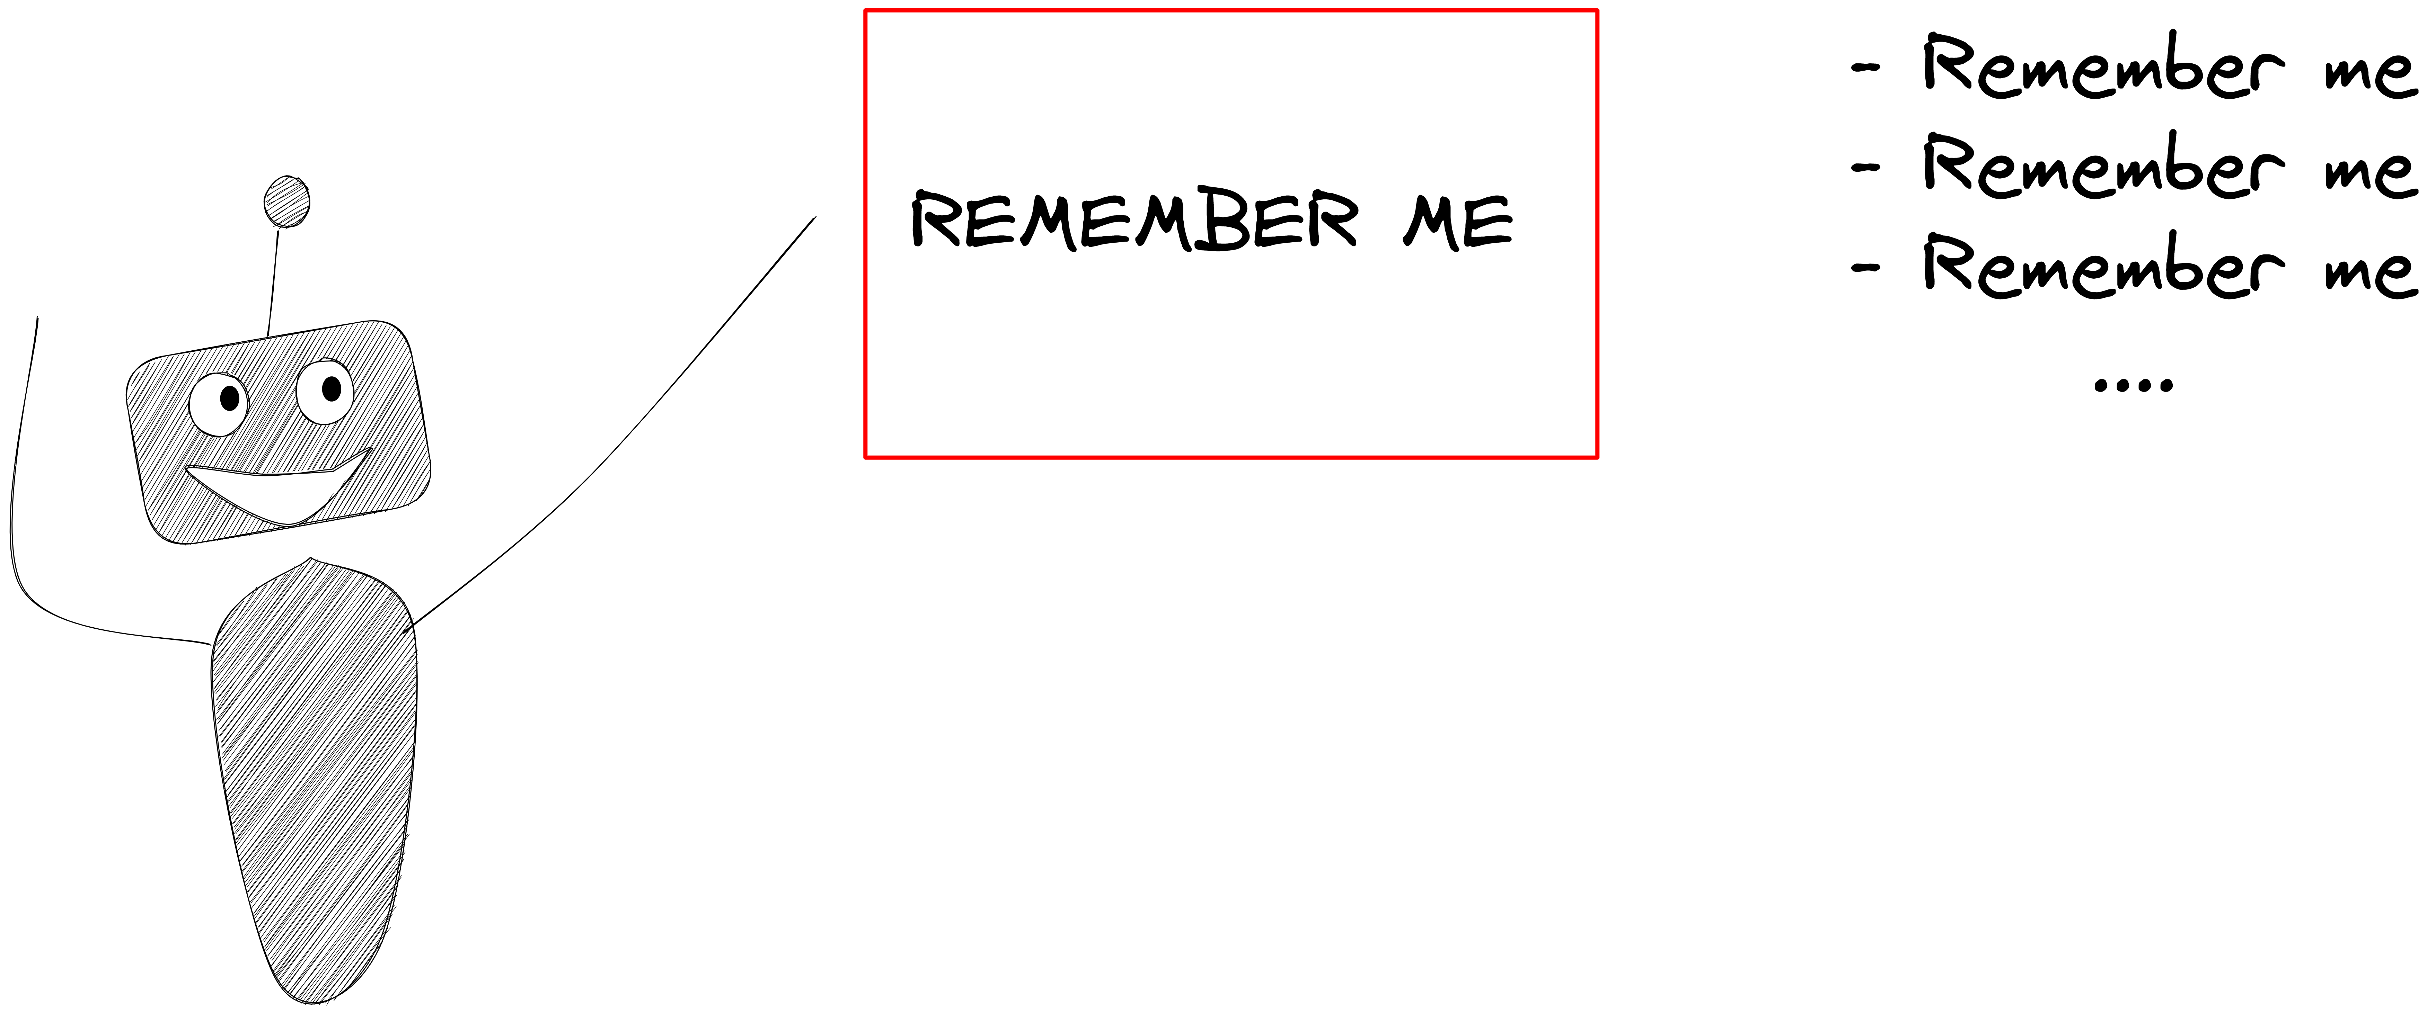
Presentation
Effective Presentations
Visuals
The more visuals, the more memorable the presentation becomes
Visuals > bullet points
Create a visual journey (e.g. spatial relationships effective at recalling info)

Slide 12
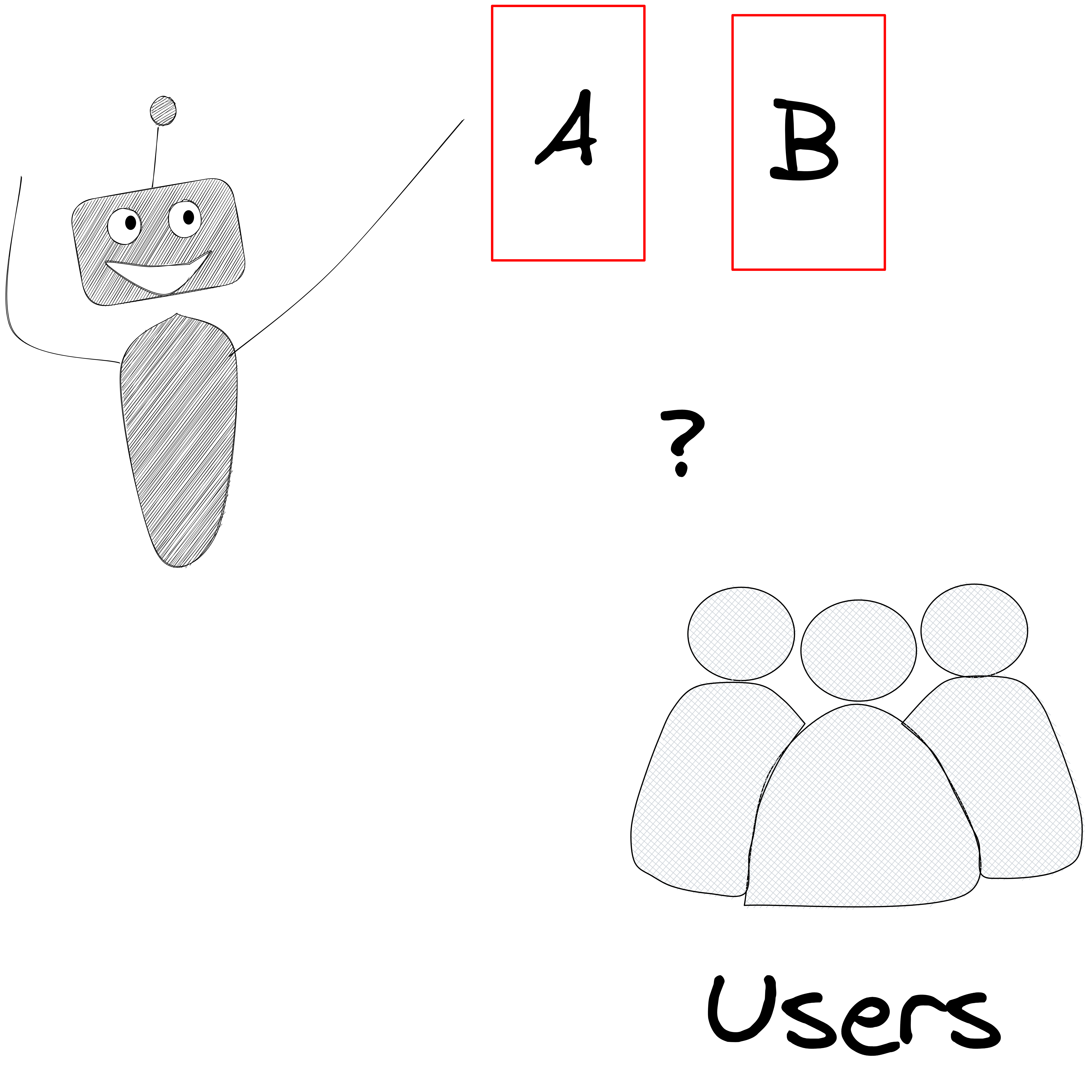
Presentation
Effective Presentations
Interactive Formats
Involve the audience in the presentation, for they will recall the information better and longer

Slide 13
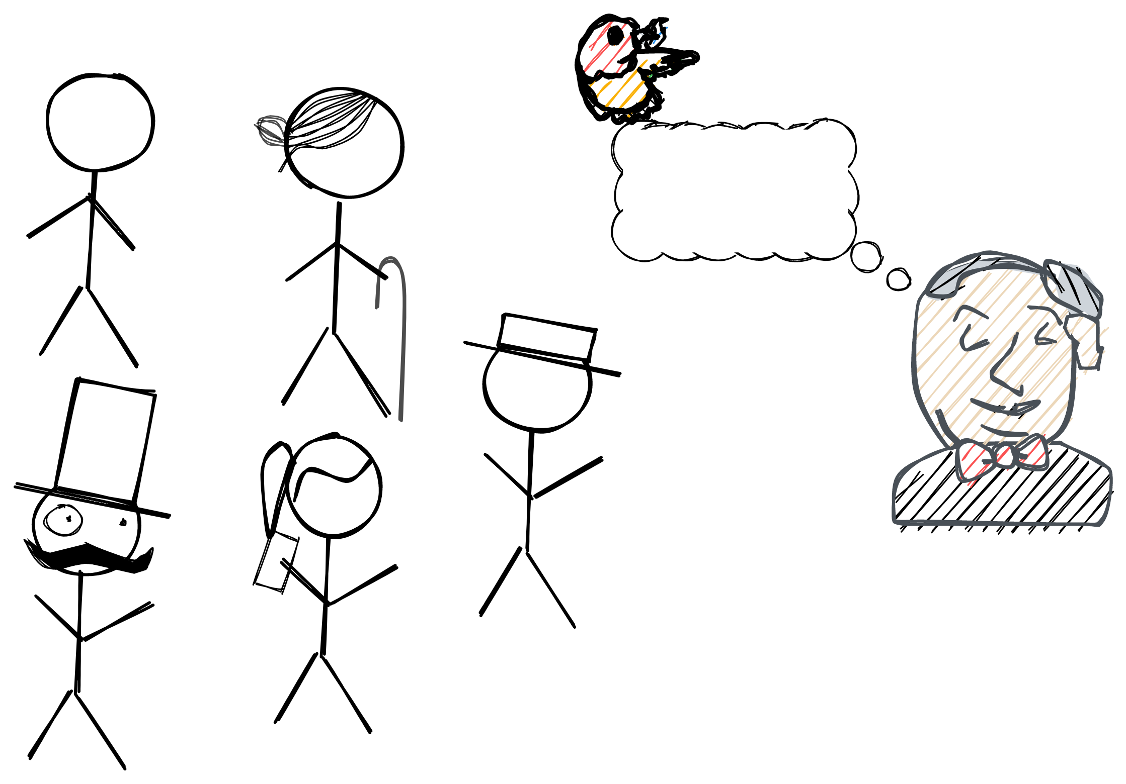
Presentation
Effective Presentations
Storytelling
Start with "Who" (I.e. the audience)
Objectives
Story arc (beginning, middle, end)
Refine details

Slide 14
Presentation
Principles of Graphical Excellence
"Graphical excellence is the well-designed presentation of interesting data- a matter of substance, of statistics, and of design." Edward, Tufte
The key to creating excellent graphical visualizations is the ability to communicate complex ideas with
Clarity
Precision
Efficiency
*Requires telling the truth by evidencing what the data is saying, and not what one wants the data to say!
*Often of multivariate nature- more than one dimension (e.g. time, space,..)

Slide 15
Presentation
Principles of Graphical Excellence
Show the data
Induce viewer to think about the substance rather than about methodology
Avoid distorting what the data has to say
Present many numbers in a small space
Make large data sets coherent
Encourage the eye to compare different pieces of data
Reveal the data at several levels of detail from broad to fine
Homogeneous purpose, descriptions, and statistics
Notes:
How does one bring about clarity, precision, and efficiency?

Slide 16
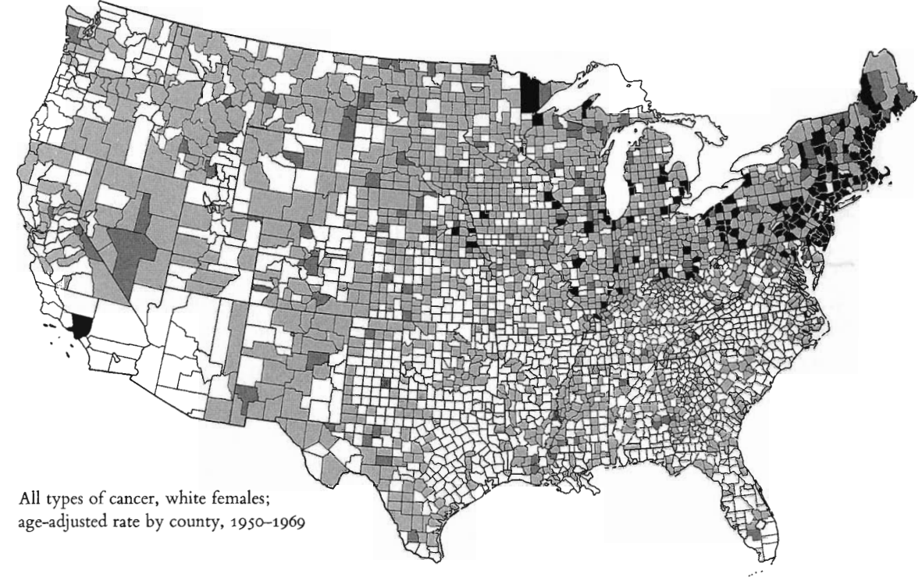
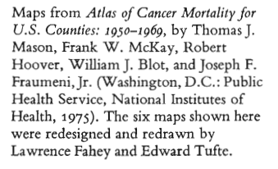
Presentation
Principles of Graphical Excellence
Notes:
How does one bring about clarity, precision, and efficiency?

Slide 17
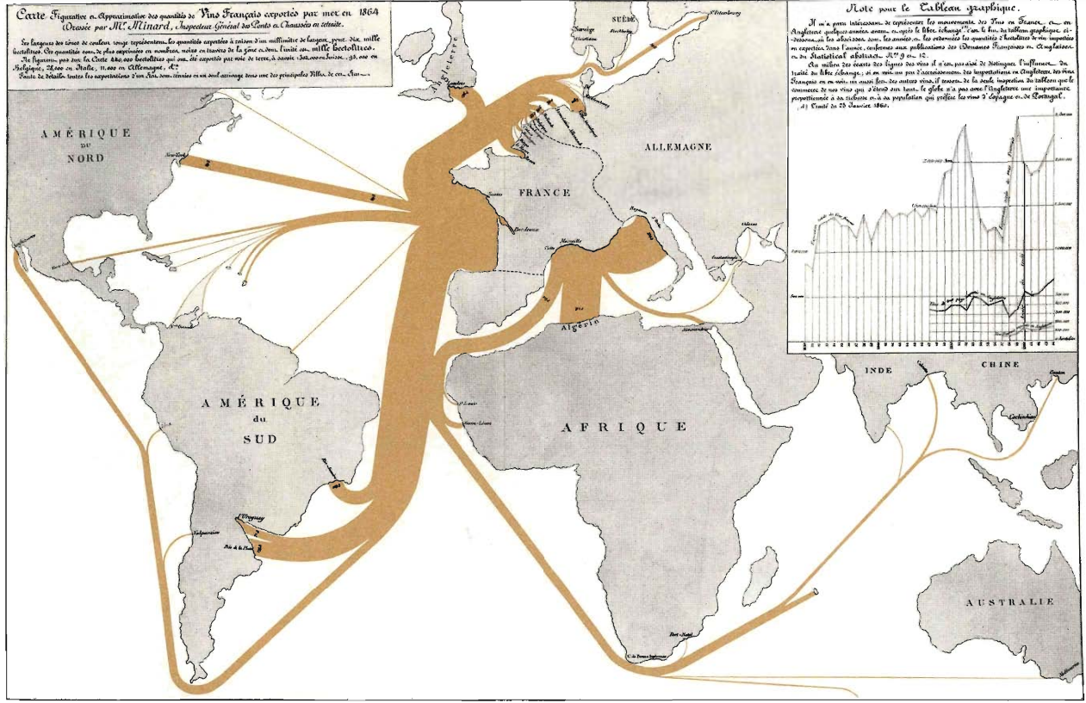
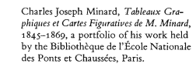
Presentation
Principles of Graphical Excellence
Notes:
How does one bring about clarity, precision, and efficiency?

Slide 18
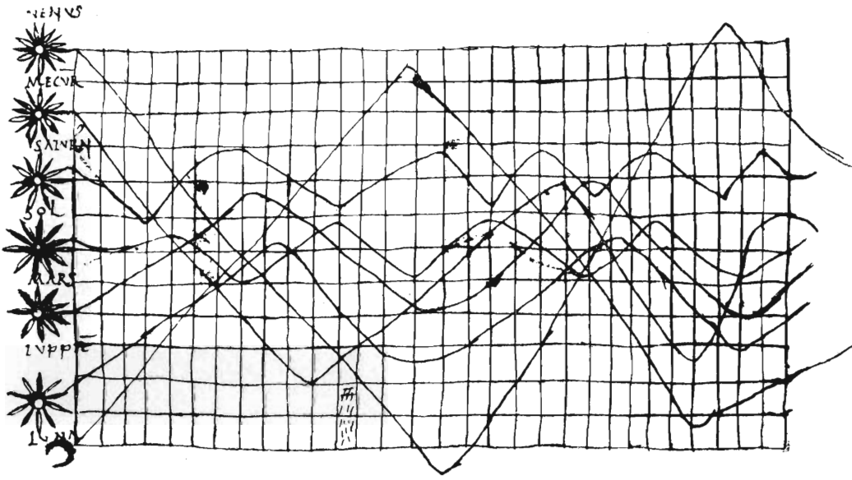
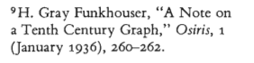
Presentation
Principles of Graphical Excellence
Notes:
How does one bring about clarity, precision, and efficiency?

Slide 19
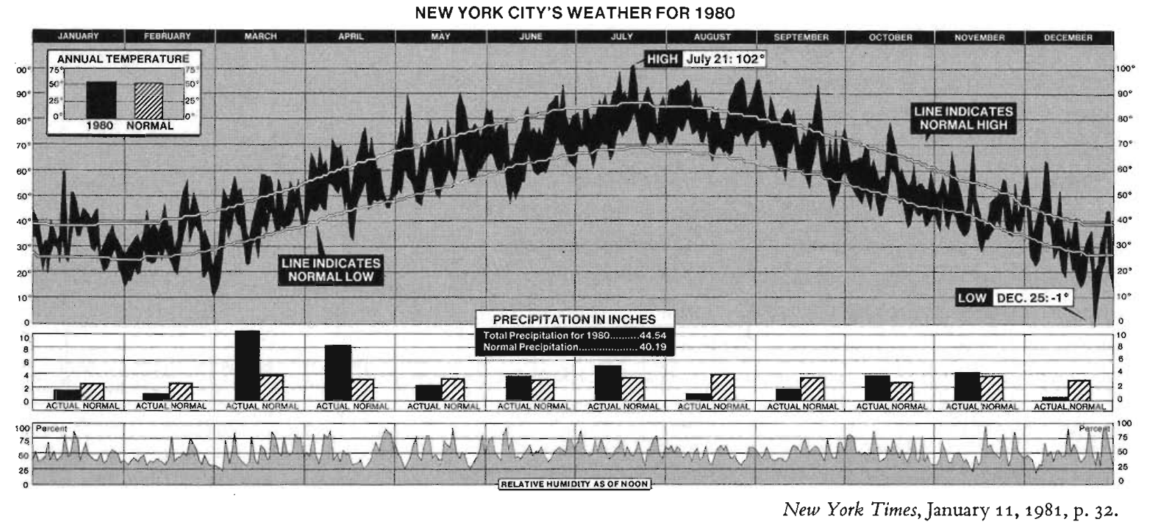
Presentation
Principles of Graphical Excellence
Notes:
How does one bring about clarity, precision, and efficiency?

Slide 20
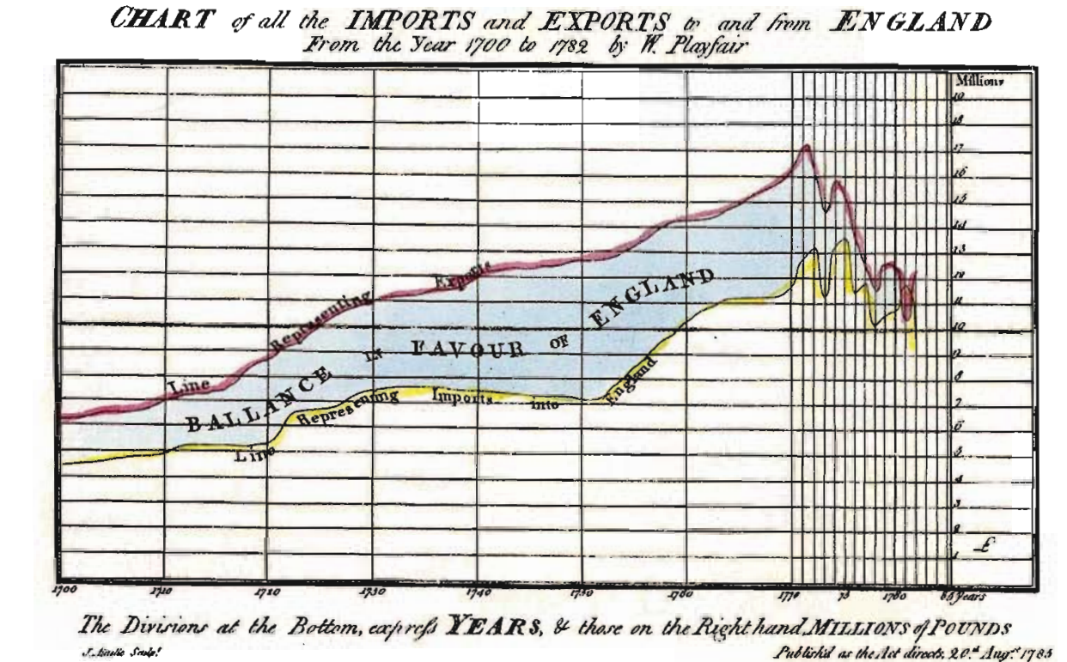
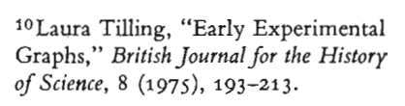
Presentation
Principles of Graphical Excellence
Notes:
How does one bring about clarity, precision, and efficiency?

Slide 21
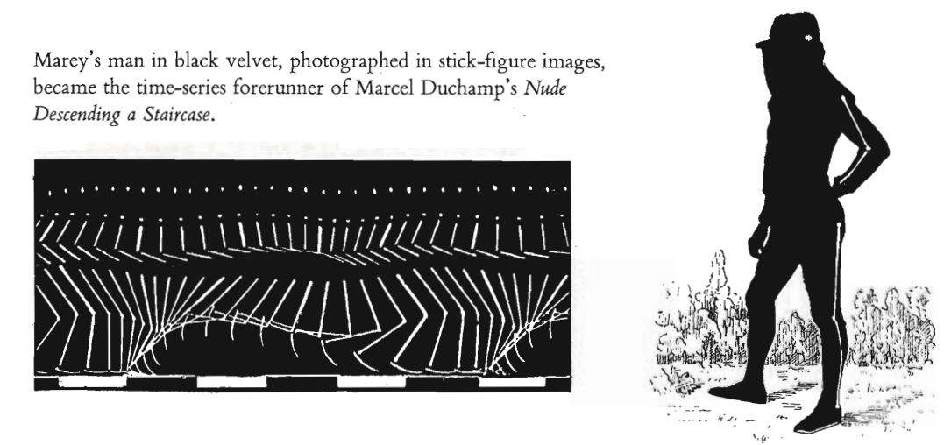
Presentation
Principles of Graphical Excellence
Notes:
How does one bring about clarity, precision, and efficiency?

Slide 22
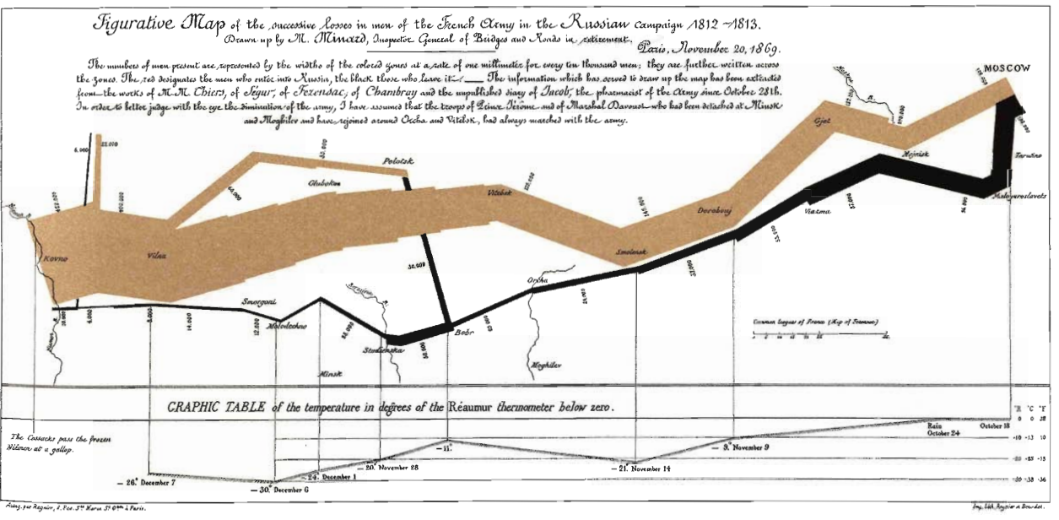
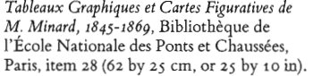
Presentation
Principles of Graphical Excellence
Notes:
How does one bring about clarity, precision, and efficiency?

Slide 23
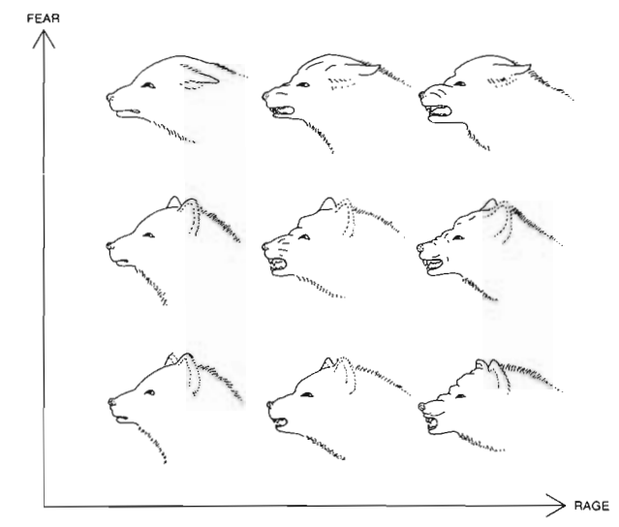
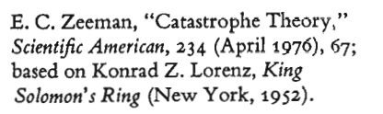
Presentation
Principles of Graphical Excellence
Notes:
How does one bring about clarity, precision, and efficiency?

Slide 24
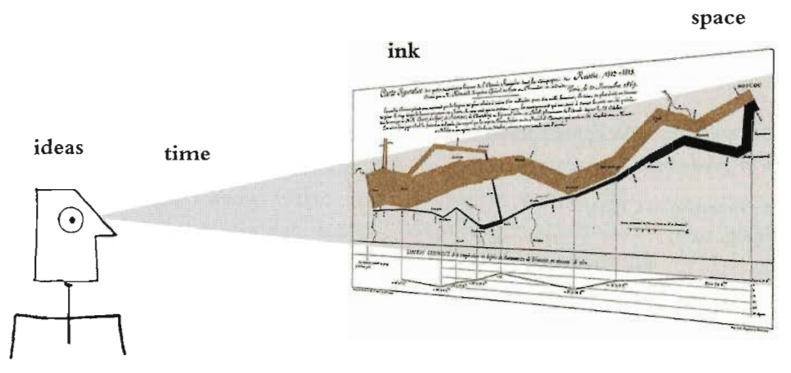
Presentation
Principles of Graphical Excellence
"Graphical excellence is that which gives to the viewer the greatest number of ideas in the shortest time with the least ink in the smallest space." Edward, Tufte
Viz by Tufte

Slide 25
Presentation
Publishing Papers
It is imperative to remember what the role of a research paper is- "an opportunity to contribute to knowledge" rather than self-aggrandizement!
Dos
Transparent, allow your data and methods to be accessible (e.g. FAIR) and mention all potential pitfalls and shortcomings, without shunning away from them.
Use multiple datasets and various benchmark metrics.
Careful with statistical significance.
Understand the models, rather than focus on the prediction accuracy
Provide visualizations, summaries
Don'ts
Generalize beyond the data, for bias and sampling error are very much real and assumptions might not always hold true.
Assume too much about the reader's experience, explain the problem, the solution, and the potential insights that come with the new discovery.

Slide 26

Presentation
Publishing Papers
Bad Papers,
Poorly motivated, unprecise, unclear, lack of thorough experimental evidence.
Hard to understand/comprehend
Impresses by "scaring away" with contorted ideas and jargon
Secretive (missing data, missing experiments, missing code, …)
Advance author
Focuses too much on results/outcome
Un-replicable results
"A bad paper reads like an advertisement."-

Slide 27
Presentation
Publishing Papers
Good Papers,
Easy to understand
Impresses by teaching
Easily reproducible (.i.e. FAIR)
Advance discipline
Focuses on understanding/concepts
"A good paper reads like a science textbook."

Slide 28
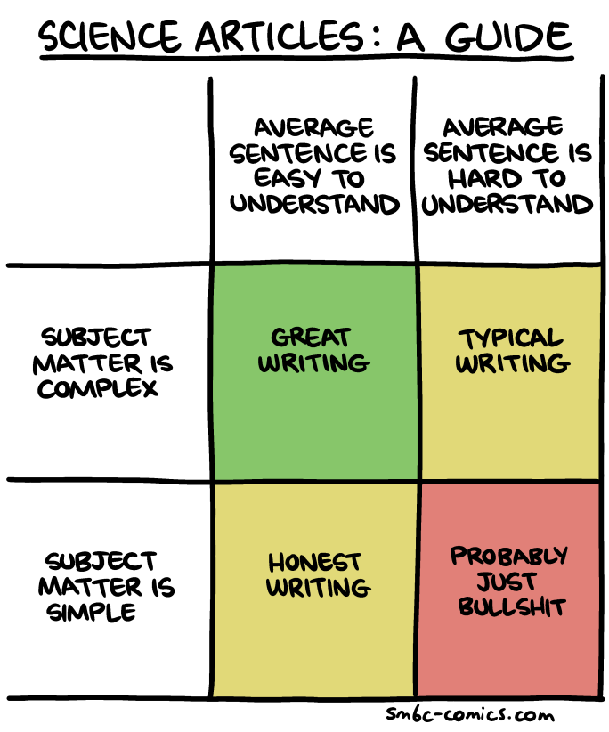
Presentation
Publishing Papers

Slide 29
Presentation
Publishing Papers
Craigs Paper
https://reader.elsevier.com/reader/sd/pii/S0304389421021099?token=F6C10ADCAD2C900F2B703008F92EB40FB12B56BB217EBA536732266D435627D04F6DDC09A6D2F81025A7E5013F1C63C8&originRegion=us-east-1&originCreation=20220622000450

Slide 30
Presentation
"Great research/insights can get lost, without the proper emphasis on delivery."

Slide 31
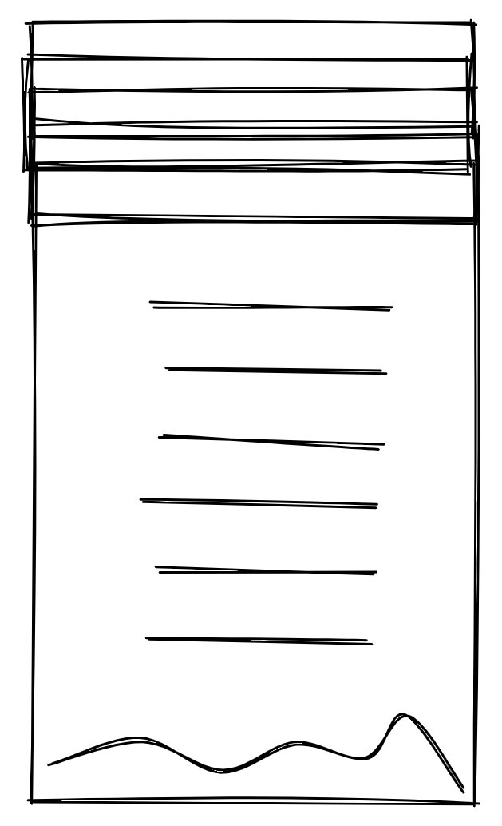
Presentation
Further Resources
Presentations
https://www.wilmu.edu/edtech/documents/the-science-of-effective-presenations---prezi-vs-powerpoint.pdf
https://www.martinsights.com/?p=1256
https://hbr.org/2020/02/present-your-data-like-a-pro
https://grigorisg9gr.github.io/machine%20learning/research%20paper/how-to-write-a-research-paper-in-machine-learning/
https://github.com/cs109/2015/blob/master/Lectures/20-Presentations.pdf
https://github.com/cs109/2015/blob/master/Lectures/06-StoryTelling.pdf
https://www.slideshare.net/thecroaker/death-by-powerpoint
Research Paper
https://grigorisg9gr.github.io/machine%20learning/research%20paper/how-to-write-a-research-paper-in-machine-learning/
https://paperswithcode.com/
Notes:
Further Explanation

Slide 32
Presentation
Further Resources
Research Paper
https://towardsdatascience.com/writing-more-successful-machine-learning-research-papers-39863ca9ea90
https://www.fda.gov/files/medical%20devices/published/US-FDA-Artificial-Intelligence-and-Machine-Learning-Discussion-Paper.pdf
https://arxiv.org/pdf/2108.02497.pdf
https://www.ic.unicamp.br/~ra023169/publications/misc1.pdf
https://www.approximatelycorrect.com/2018/01/29/heuristics-technical-scientific-writing-machine-learning-perspective/
Books
https://www.edwardtufte.com/tufte/books_vdqi (Tufte)
Notes:
Further Explanation

Slide 33


Overview
Think of the presented overview as a mere "biscuit dipping", and now there comes the actual "feast."
Data Science Overview
Machine Learning

Slide 34
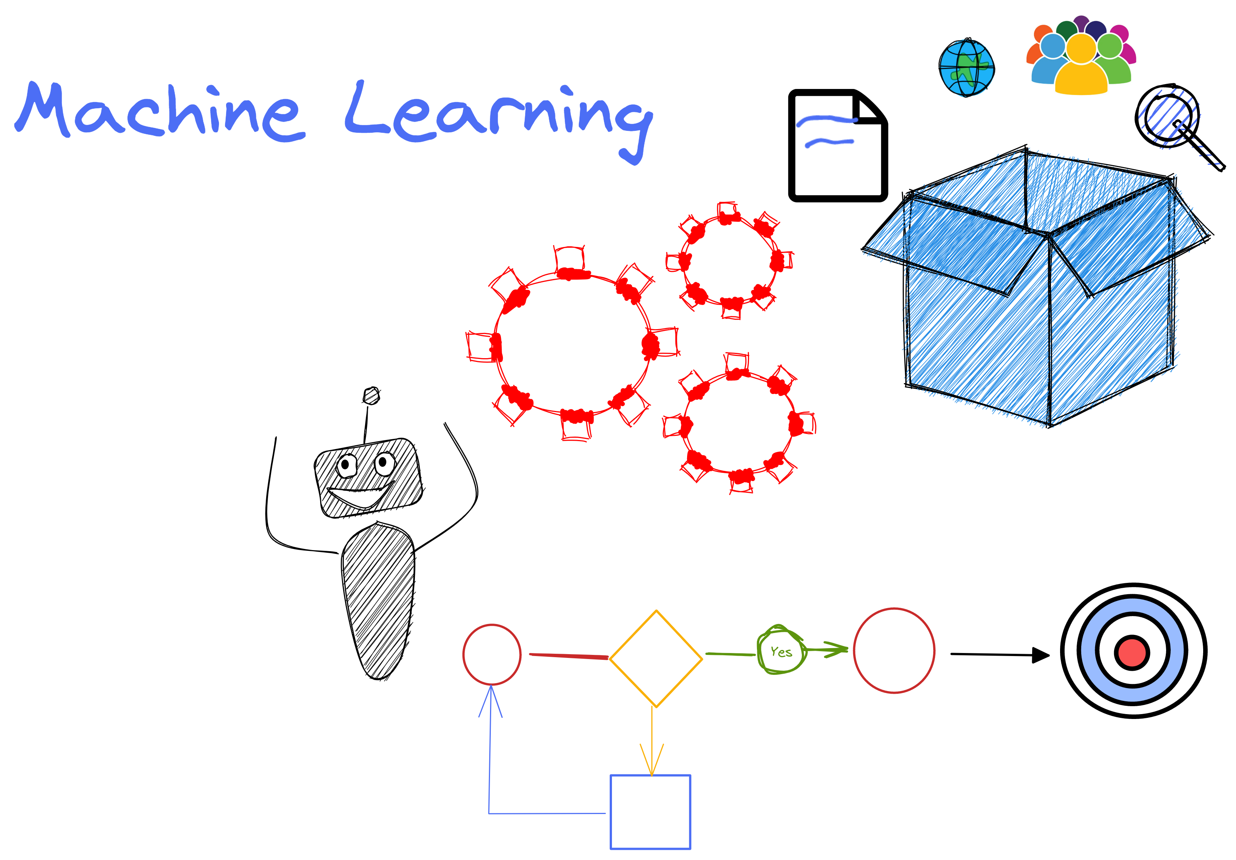
Notes:
Further Notes
- https://excalidraw.com/#room=9b9c73fa988f1af7e81f,rRn1h-2NlXVYqTQRj_TzaA

Slide 35
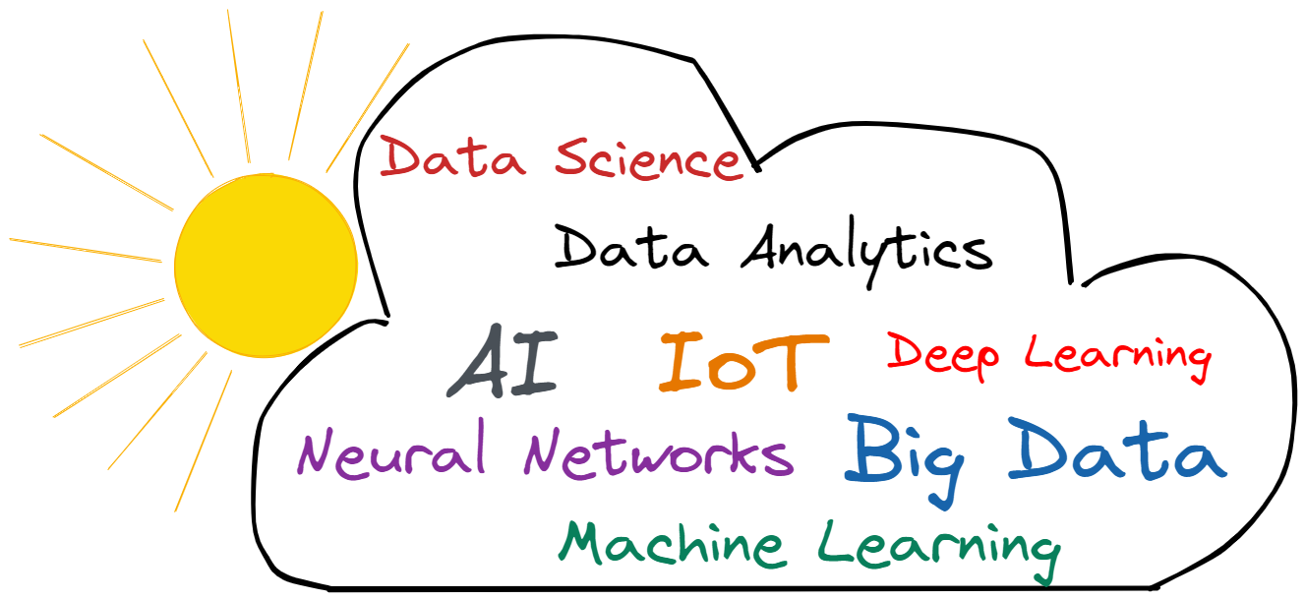
Machine Learning
Confusing Semantics
Although most of these terms are related and overlap in their application, they're distinct. Let us shine some light into the blurriness of such matters, and by the end of this module, one should be comfortable with the distinction and similarity encompassing each term.

Slide 36
Machine Learning
Data Science vs Data Analytics
Data science focuses on broad goals and discoveries attempting to find new questions in an effort to drive innovation. It is somewhat ambiguous in nature, and not linear for it involves multiple disciplines (statistics, computer science, ….). It focuses more on machine learning and predictive modeling in order to solve complex problems.
Data analysis focuses on specific objectives that are congruent to business needs. It uses data as the ultimate compass to “truth” by deploying the necessary statistics and models.
"If data science is a home for all the methods and tools, data analytics is a small room in that house. Data analytics is more specific and concentrated than data science."

Slide 37
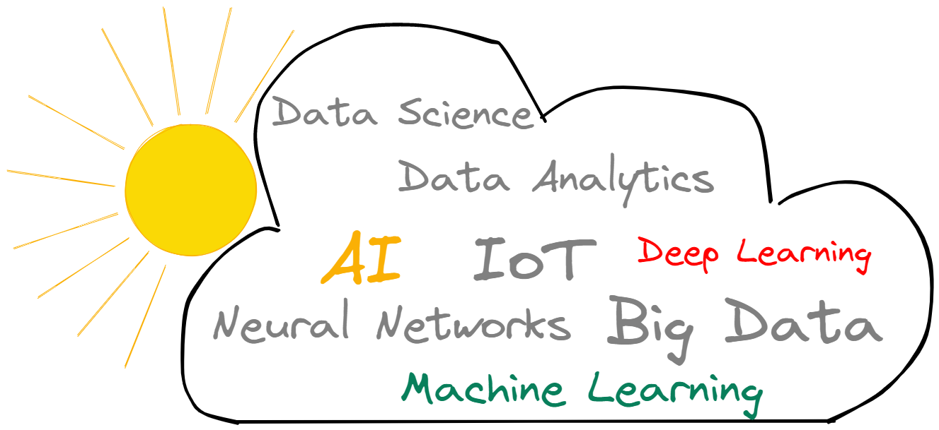
Machine Learning
Artificial Intelligence (AI) vs Machine Learning (ML) vs Deep Learning (DL)

Slide 38

Machine Learning
What is Artificial Intelligence (AI)?
"It is the science and engineering of making intelligent machines, especially intelligent computer programs. It is related to the similar task of using computers to understand human intelligence, but AI does not have to confine itself to methods that are biologically observable."
AI seems to have started with Alan Turing in the 1950s. At the root of it all was the question “Can machines think?” In order to provide a definitive answer Alan proposed a test (today known as the Turing test), in which a human would interact with a machine by way of a text-based conversation, in the case that the human evaluator wouldn’t be able to differentiate between the machine and a fellow human, then the machine is said to have passed the test.
“The test results do not depend on the machine's ability to give correct answers to questions, only how closely its answers resemble those a human would give.”

Slide 39
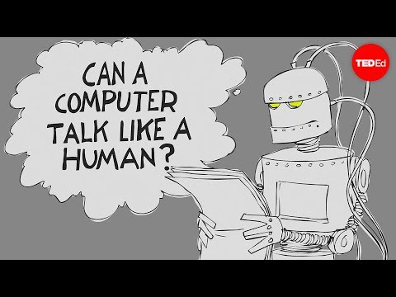
Machine Learning
Turing Test

Slide 40
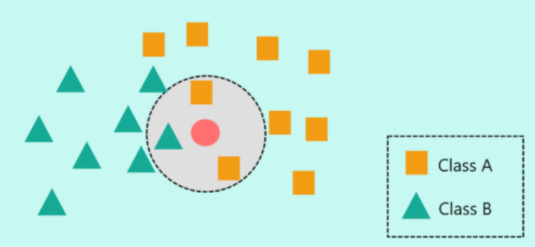
Machine Learning
What is Machine Learning (ML)?
Machine Learning, often referred to as statistical learning, is a subfield artificial intelligence that is concerned with the development of algorithms “that can automatically detect patterns in data, and then use the uncovered patterns to predict future data, or to perform other kinds of decision making under uncertainty.”
At its core, Machine Learning attempts to solve real world problems by collecting data and then building a statistical model that best explains the data with the intention to learn useful patterns in relation to the problem.
"Statistical learning refers to a vast set of tools for understanding data."

Slide 41
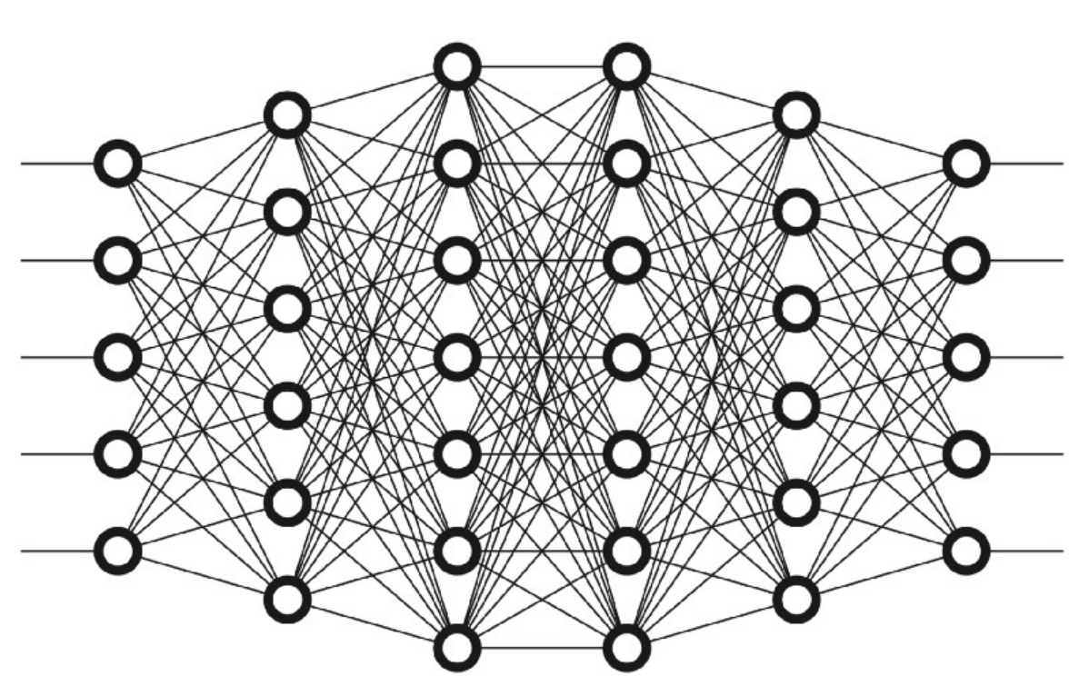
Machine Learning
What is Deep Learning (DL)?
“Deep Learning is a subfield of machine learning concerned with algorithms inspired by the structure and function of a brain's networks of neurons.”
Deep learning brakes the concepts that it is attempting to learn into a hierarchical form by breaking complex tasks such as recognizing pictures, to simpler tasks, such as recognizing edges and shapes. The “deep” refers to the number of layers from simple to complex that have been built in order to learn.
One of the key features of deep learning is its ability to provide better results as more data is “fed” to it; more data coupled with the intensive processing power of the 21st century makes of deep learning a possible reality that can go beyond traditional machine learning algorithms.

Slide 42
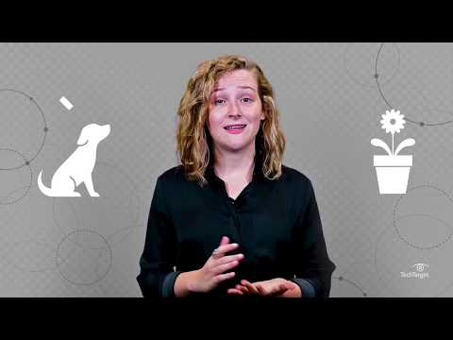
Machine Learning
Deep Learning

Slide 43
Machine Learning
Bringing it All Together
Although, artificial intelligence, machine learning, and deep learning are all related and somewhat attempt to solve problems in similar domains, they are distinctive enough to merit their own name and attention. They are not the same, rather, they are different parts of the same entity.
AI is the broad umbrella under which all methods attempting to make machines more intelligent fall under.
ML encompasses a series of concepts and processes that make machines intelligent.
DL is one particular method and process that has at its inspiration the brain's structure.
Artificial
Intelligence
Machine
Learning
Deep Learning

Slide 44

Machine Learning
ML use cases

Slide 45
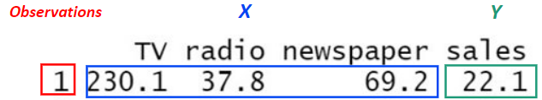
Machine Learning
Supervised vs Unsupervised
Machine learning problems fall into one of two categories: supervised or unsupervised.
Supervised, each observation is composed of a predictor X (or set of predictors) and a response Y. In this kind of scenario, the machine learning model (a.k.a. the estimate of the function f) is attempting to relate the predictor(s) X with the response Y with the ultimate goal of accurately predicting future observations (prediction) or better understanding the underlying relationships between predictors and response (inference).

Slide 46
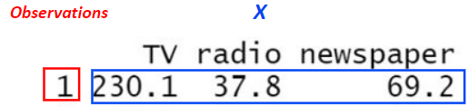
Machine Learning
Supervised vs Unsupervised
Unsupervised, each observation is composed of a predictor X (or set of predictors) but NO associated response! In this setting, it is almost "working blindly" for there isn't a supervising response variable that can supervise the analysis. The objective of such analysis is to create models that allow for an understanding of the underlying relationships. A good example that shines light into unsupervised analysis is clustering, which is a modeling technique that attempts to cluster together (i.e. group together) similar observations based on the patterns found in the predictor space.

Slide 47
Machine Learning
Classification vs Regression
Often, one might hear of a "regression problem" or "classification problem." These pertain to the nature of the response (Y), which is found in the supervised setting.
Regression, the response (Y) is quantitative (i.e. numerical value).
Classification, the response (Y) is qualitative (i.e. classes/categories).
As a result, the eventual choice of choosing a particular machine learning model (a.k.a. statistical learning method) is based on the nature of the response, if quantitative or qualitative. The nature of the predictors is considered less important.

Slide 48
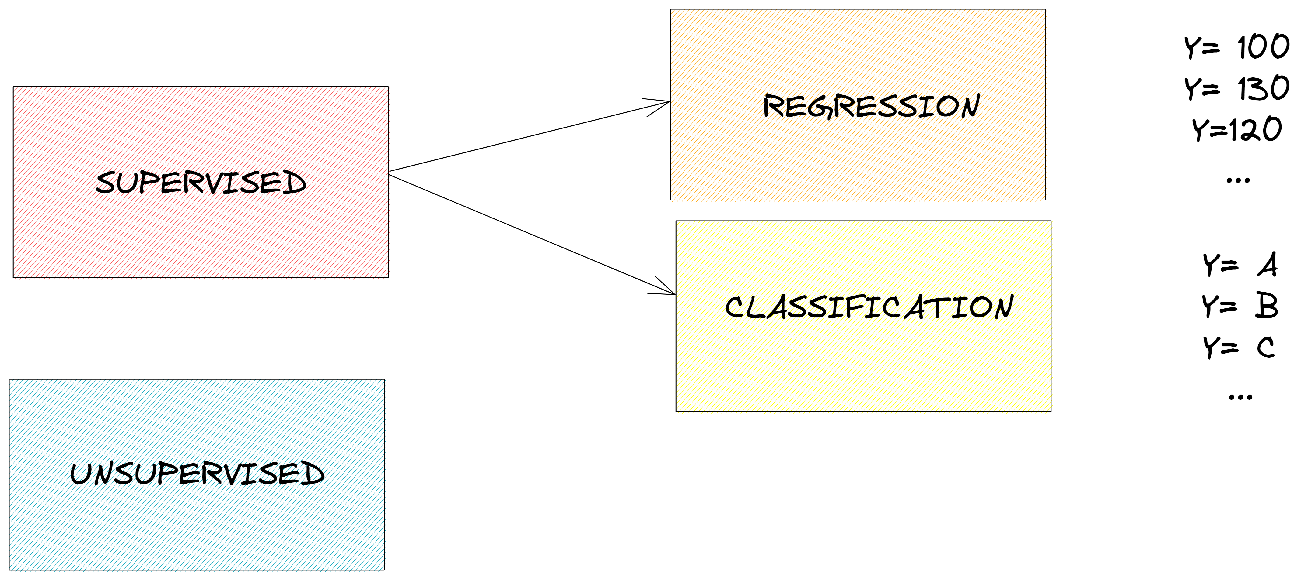
Machine Learning
Classification vs Regression

Slide 49
Machine Learning – A Deeper Dive
Reinforcement Learning
Reinforcement learning: http://incompleteideas.net/book/RLbook2020.pdf
+ Leila's Material

Slide 50
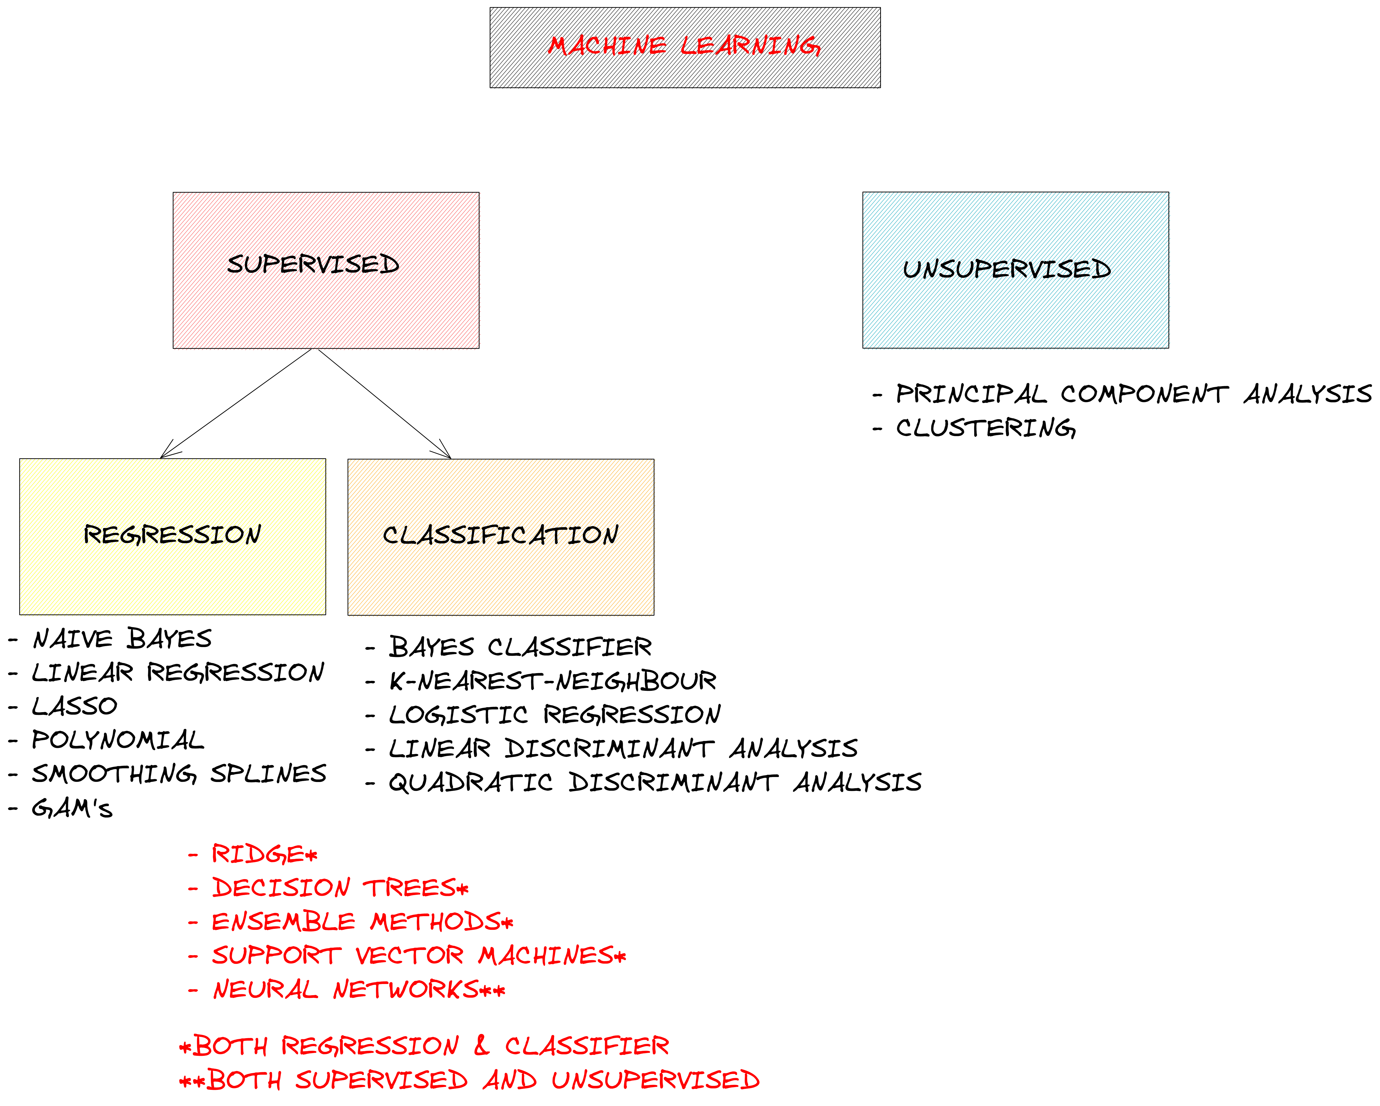
Machine Learning
Popular Models
Notes:
Further Notes
https://www.mathworks.com/help/stats/machine-learning-in-matlab.html

Slide 51
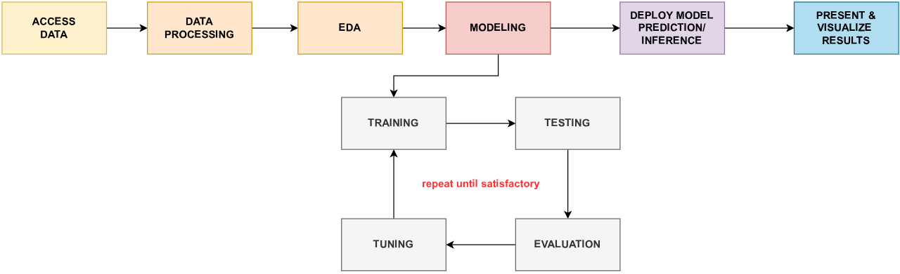
Machine Learning
Typical ML Workflow

Slide 52
Machine Learning
"Do I even need ML?"
"Machine learning has some magical and awe-inspiring applications, extending the range of applications we thought possible to be solved using a computer. However, the awesome potential of machine learning does not mean that it automatically solves our challenges."
"Machine learning is not a silver bullet for all challenges!"
Notes:
Further Notes

Slide 53
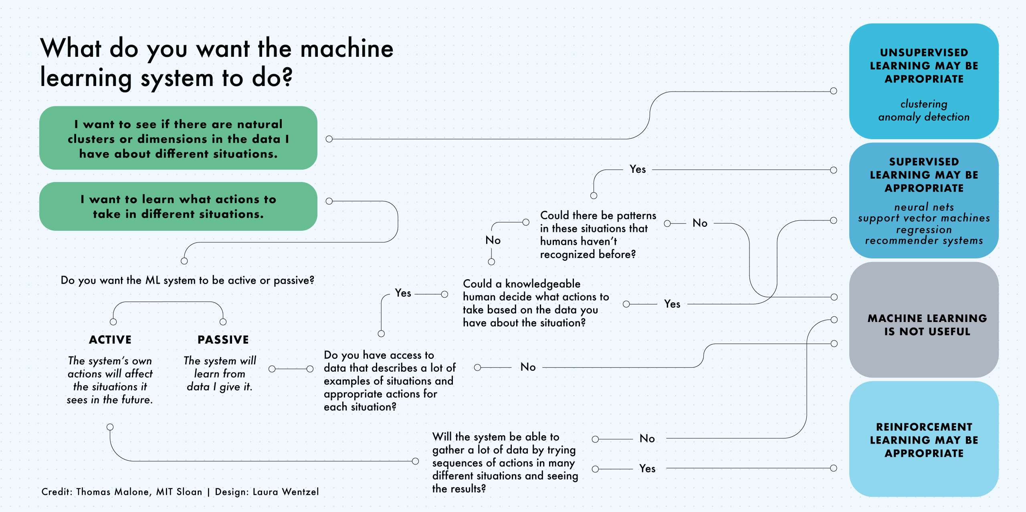

Slide 54
Machine Learning
Topics /ideas Worth Covering
Feature preparation
One hot encoding
Normalization
Dummy variables
Scale
Data reduction (feature discovery)
Cross validation
Data leakage

Slide 55
MACHINE LEARNING
Further Resources
Machine Learning
https://docs.microsoft.com/en-us/windows/ai/windows-ml/what-is-a-machine-learning-model
https://databricks.com/glossary/machine-learning-models
https://towardsdatascience.com/all-machine-learning-models-explained-in-6-minutes-9fe30ff6776a
https://www.javatpoint.com/machine-learning-models
https://towardsdatascience.com/problem-solving-as-data-scientist-a-case-study-49296d8cd7b7
https://www.simplilearn.com/tutorials/machine-learning-tutorial/machine-learning-interview-questions
https://www.mathworks.com/help/stats/machine-learning-in-matlab.html
https://towardsdatascience.com/workflow-of-a-machine-learning-project-ec1dba419b94
Notes:
Further Explanation

Slide 56
MACHINE LEARNING
Further Resources
Courses
https://developers.google.com/machine-learning/crash-course/ml-intro
https://github.com/cs109/2015/tree/master/Lectures
https://carpentries-incubator.github.io/machine-learning-novice-sklearn/08-learn-more/index.html
Books
https://www.amazon.com/Machine-Learning-Probabilistic-Perspective-Computation/dp/0262018020/
https://www.amazon.com/dp/1461468485
https://www.statlearning.com/
https://www.amazon.com/Practical-Statistics-Data-Scientists-Essential/dp/1491952962/
https://www.amazon.com/Feature-Engineering-Machine-Learning-Principles/
Data Analytics vs Data Science
https://www.youtube.com/watch?v=yR2wWQYiVKM
Notes:
Further Explanation

